Slide 1

Internet Of Things (IoT) Advanced
Raghu Prasad
9845547471
www.kaushalya.tech
FB : https://www.facebook.com/raghuprasadkonandur/
Skill Up-Skill Re-Skill
Excellence in action

Slide 2
Introduction
Raghu Prasad – BE, MS
Total of 24 years of experience
7 years as a lecturer in an Engineering College
17 Years into IT
Worked with companies like CISCO,CSC,ICICI,First Apex – NTT Data
Currently into Corporate training and consultancy
Worked with corporates and public sector
Service Offerings – In person/On-line/Corporate/Academic Institutes
Technologies – Java,Python,Web technologies,Java Script technologies (MEAN stack),IOT,Test Automation,Machine Learning,Artificial Intelligence,ERP
Customers – L & T,NextGen,Incarnus,BGS-IT,Sindhi College

Slide 3
Topics
Communication protocols – Deep dive
Cloud Computing
IoT Platforms
IoT Consortiums
AWS IoT Deep dive
Data analysis
Design Considerations and IoT Security
IoT Opportunities
Demonstration

Slide 4
Communication Protocol – MQTT – Deepdive
What is MQTT?
MQTT stands for MQ Telemetry Transport. It is a publish/subscribe, extremely simple and lightweight messaging protocol, designed for constrained devices and low-bandwidth, high-latency or unreliable networks. The design principles are to minimise network bandwidth and device resource requirements whilst also attempting to ensure reliability and some degree of assurance of delivery. These principles also turn out to make the protocol ideal of the emerging “machine-to-machine” (M2M) or “Internet of Things” world of connected devices, and for mobile applications where bandwidth and battery power are at a premium.
Who invented MQTT?
MQTT was invented by Dr Andy Stanford-Clark of IBM, and Arlen Nipper of Arcom (now Eurotech), in 1999.
Where is MQTT in use?
MQTT has been widely implemented across a variety of industries since 1999.
Is MQTT a standard?
As of March 2013, MQTT is in the process of undergoing standardisation at OASIS.
The protocol specification has been openly published with a royalty-free license for many years, and companies such as Eurotech (formerly known as Arcom) have implemented the protocol in their products.
In November 2011 IBM and Eurotech announced their joint participation in the Eclipse M2M Industry Working Group and donation of MQTT code to the proposed Eclipse Paho project.

Slide 5
Communication Protocol – MQTT – Deepdive
How does MQTT relate to SCADA protocol and MQIsdp?
The “SCADA protocol” and the “MQ Integrator SCADA Device Protocol” (MQIsdp) are both old names for what is now known as the MQ Telemetry Transport (MQTT). The protocol has also been known as “WebSphere MQTT” (WMQTT), though that name is also no longer used.
What is WebSphere MQ Telemetry?
This is a product from IBM which implements the MQTT protocol in a very scalable manner and which interoperates directly with the WebSphere MQ family of products.
Are there standard ports for MQTT to use?
Yes. TCP/IP port 1883 is reserved with IANA for use with MQTT. TCP/IP port 8883 is also registered, for using MQTT over SSL.
Does MQTT support security?
You can pass a user name and password with an MQTT packet in V3.1 of the protocol. Encryption across the network can be handled with SSL, independently of the MQTT protocol itself (it is worth noting that SSL is not the lightest of protocols, and does add significant network overhead). Additional security can be added by an application encrypting data that it sends and receives, but this is not something built-in to the protocol, in order to keep it simple and lightweight.
Notable MQTT projects
http://mqtt.org/projects

Slide 6
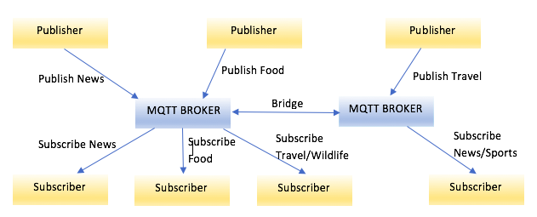
MQTT – Terminologies
Terminology

Slide 7
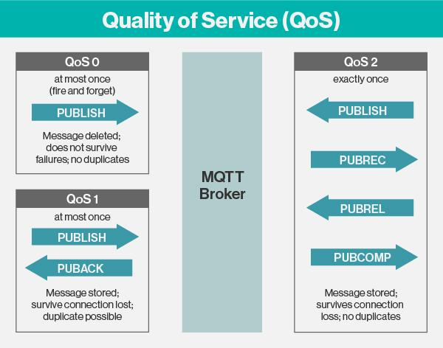
MQTT – Terminologies
Terminology

Slide 8
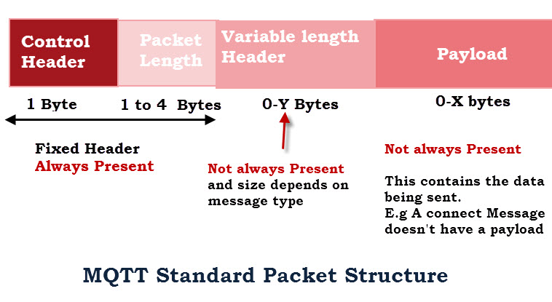
MQTT – Terminologies
Terminology (http://www.steves-internet-guide.com/mqtt-protocol-messages-overview/)

Slide 9
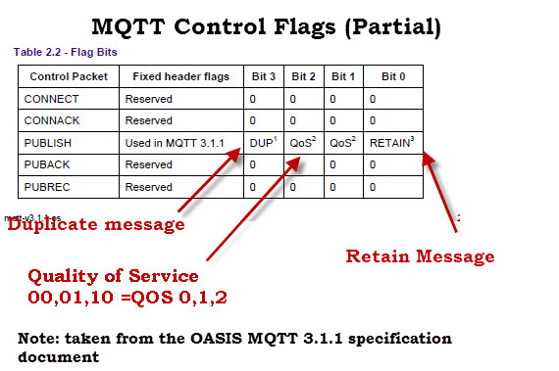
MQTT – Terminologies
Terminology

Slide 10
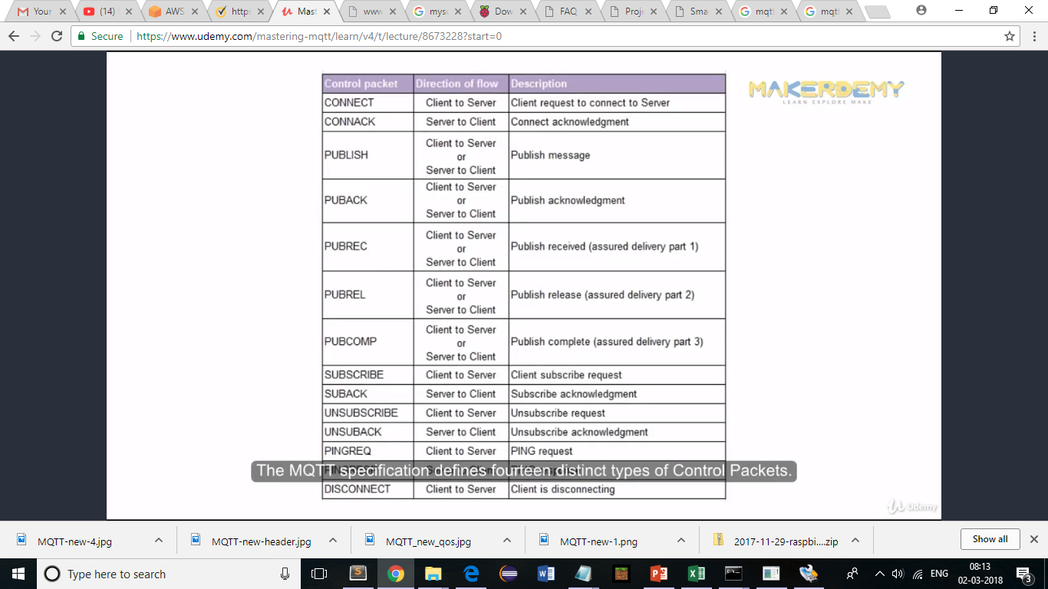
MQTT – Terminologies
Terminology

Slide 11
MQTT - Demo
Broker
M2M Eclipse(m2m.eclipse.org)
Mosquitto (https://mosquitto.org/)
Mosquitto installed on the laptop
Client
MQTT.fx (Web client)
MyMQTT (Android client)
MQTTLens(Chrome Extension)

Slide 12
MQTT – Demo – Scenario 1
Broker – Mosquitto installed on system
Client - Mosquitto installed on system (Publisher and Subscriber)
Steps
Download mosquitto (https://mosquitto.org/download/)
Install mosquito
Start mosquitto as a windows service
Publish and Subscribe

Slide 13
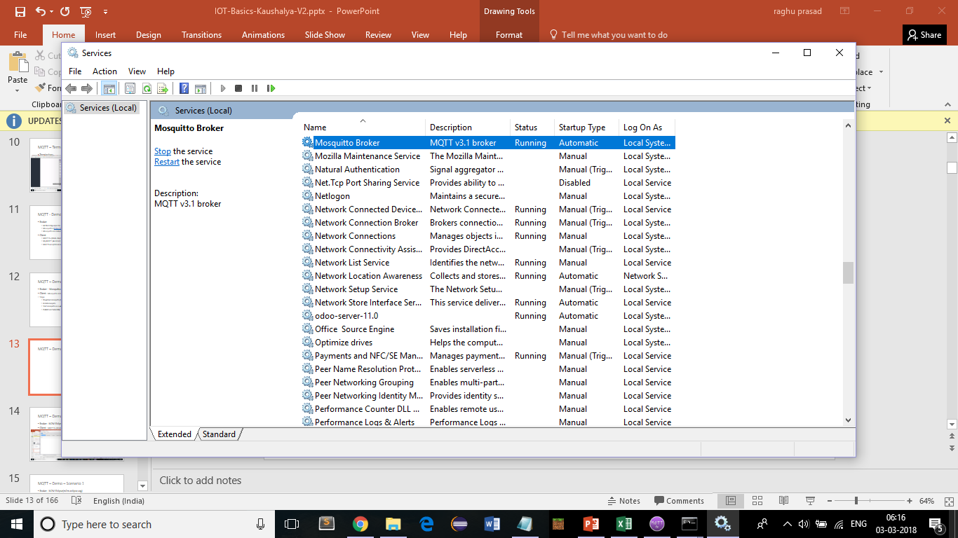
MQTT – Demo – Scenario 1

Slide 14
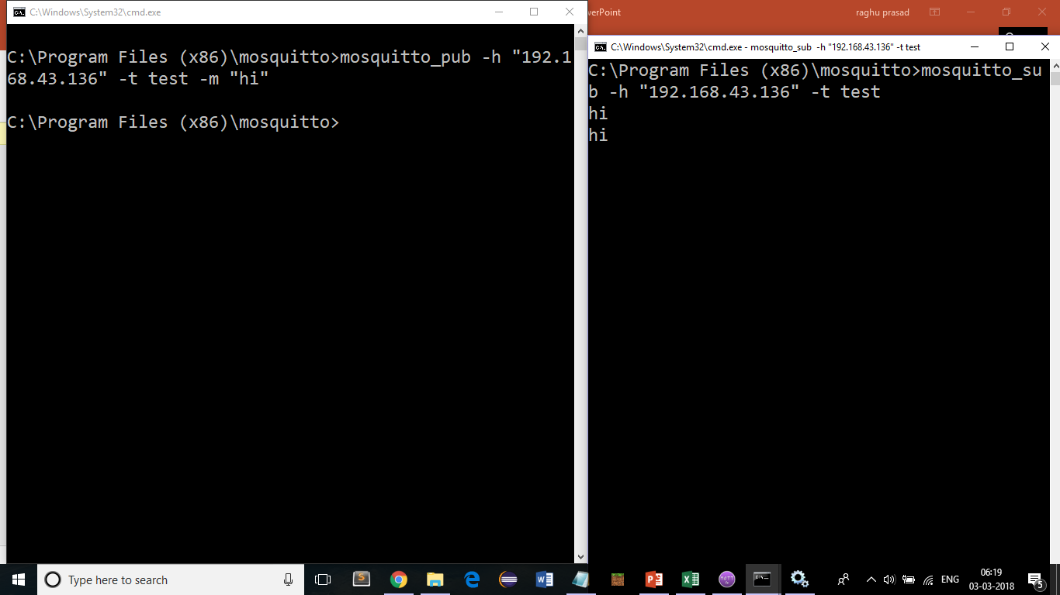
MQTT – Demo – Scenario 1

Slide 15
MQTT – Demo – Scenario 1
To check running of mosquitto on port 1883
netstat -an | findstr 1883
Publish message
mosquitto_pub -h "192.168.43.136" -t test -m "hi"
Subscribe to message
mosquitto_sub -h "192.168.43.136" -t test

Slide 16
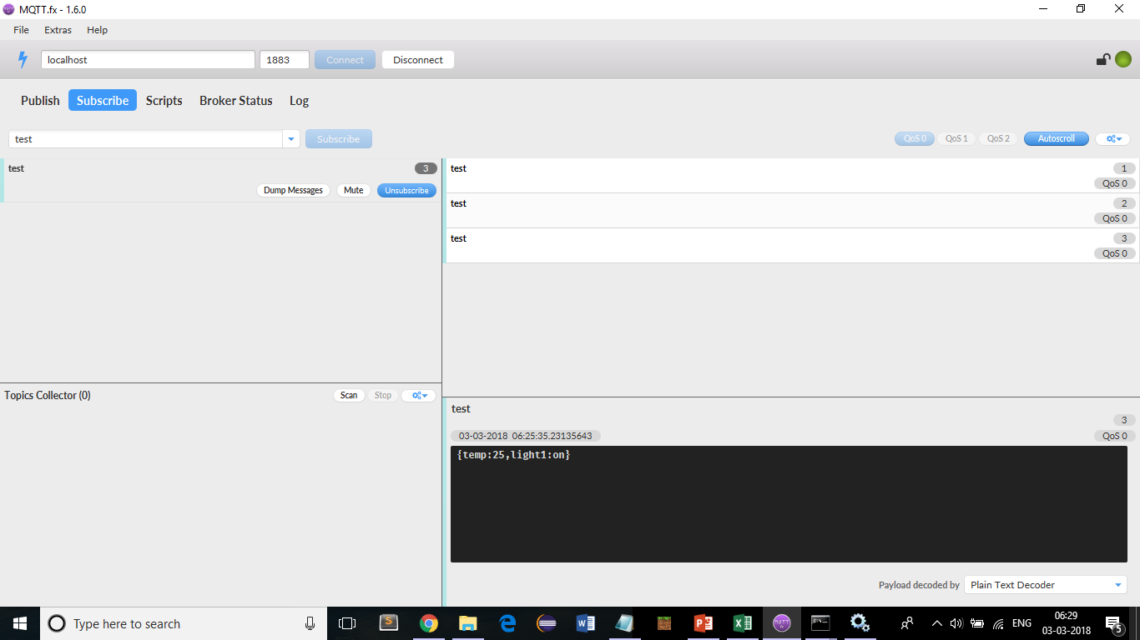
MQTT – Demo – Scenario 2
Broker – Mosquitto on local system
Client - MQTT.fx (Web client) (Download - http://mqttfx.jensd.de/index.php/download http://mqttfx.jensd.de/index.php/download

Slide 17
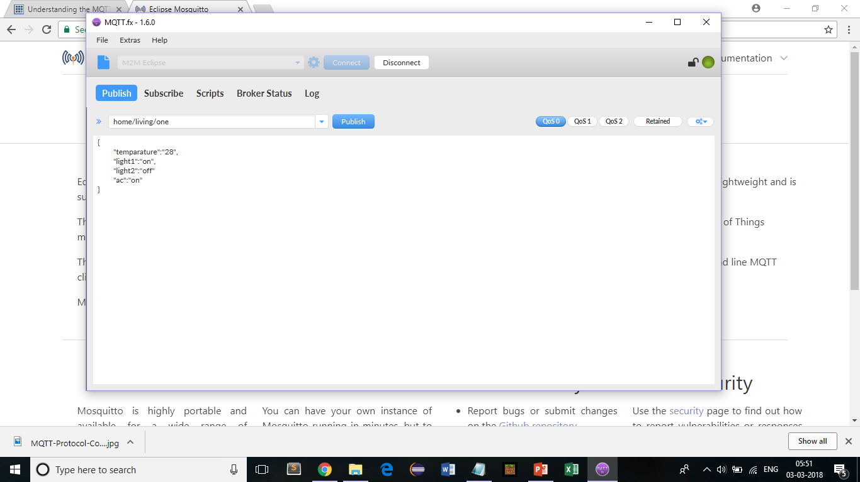
MQTT – Demo – Scenario 3
Broker – Mosquitto on local system
Client –MyMQTT (Android App)

Slide 18
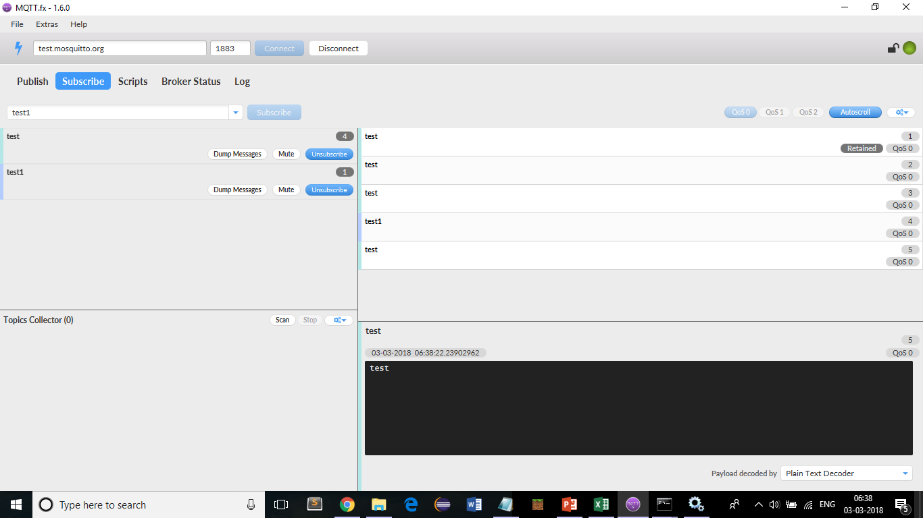
MQTT – Demo – Scenario 4
Broker - http://test.mosquitto.org/
Client - MQTT.fx (Web client) (usage of # and +)

Slide 19
Raspberry pi
https://www.raspberrypi.org/
The Raspberry Pi is a series of small single-board computers developed in the United Kingdom by the Raspberry Pi Foundation to promote the teaching of basic computer science in schools and in developing countries.The original model became far more popular than anticipated,selling outside its target market for uses such as robotics. It does not include peripherals (such as keyboards, mice and cases). However, some accessories have been included in several official and unofficial bundles.
According to the Raspberry Pi Foundation, over 5 million Raspberry Pis were sold by February 2015, making it the best-selling British computer.By November 2016 they had sold 11 million units and 12.5m by March 2017, making it the third best-selling "general purpose computer".In July 2017, sales reached nearly 15 million.

Slide 20
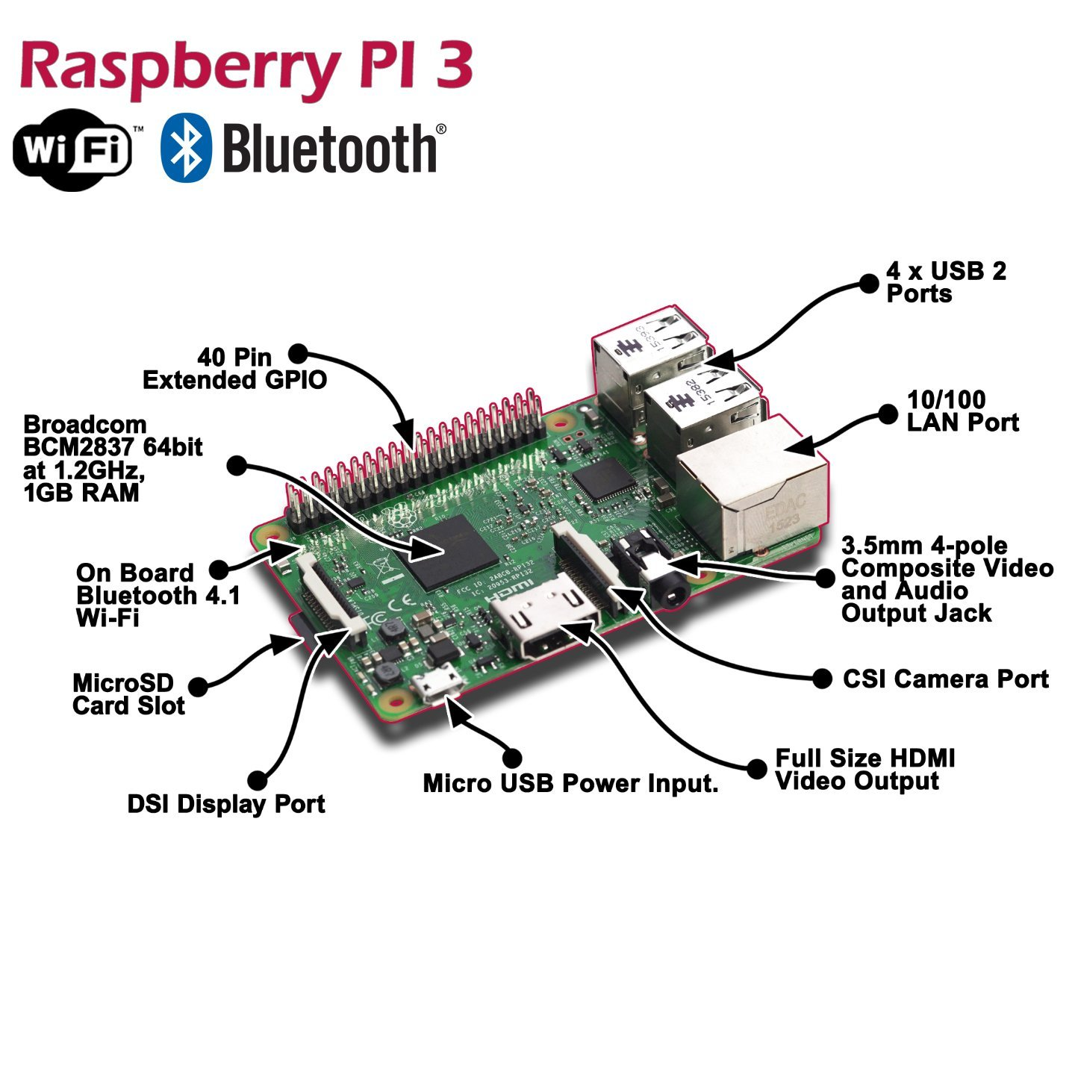
Raspberry pi

Slide 21
Projects on Raspberry pi
http://www.trustedreviews.com/opinion/best-raspberry-pi-projects-pi-3-pi-zero-2949390
An Amazon Alexa-powered dash cam
An electric skateboard
A disposable GIF camera
An electronic chess board
A Kodi media centre
A DIY NES Classic Mini
A digital DJ system
Automated entrance music
A robot arm
Multiroom audio for under £100
A walkie-talkie
A film-to-digital transfer system
A tiny retro games console
A magic mirror
A mini retro Macintosh Read more at http://www.trustedreviews.com/opinion/best-raspberry-pi-projects-pi-3-pi-zero-2949390#WlFlr3fl5UFfl88j.99

Slide 22
Cloud Computing
Cloud computing is an information technology paradigm that enables access to shared pools of configurable system resources and higher-level services that can be rapidly provisioned with minimal management effort, often over the Internet
In other words it is use of remote servers on the internet to store, manage and process data rather than a local server or your personal computer.
Cloud computing relies on sharing of resources to achieve coherence and economies of scale, similar to a public utility.

Slide 23
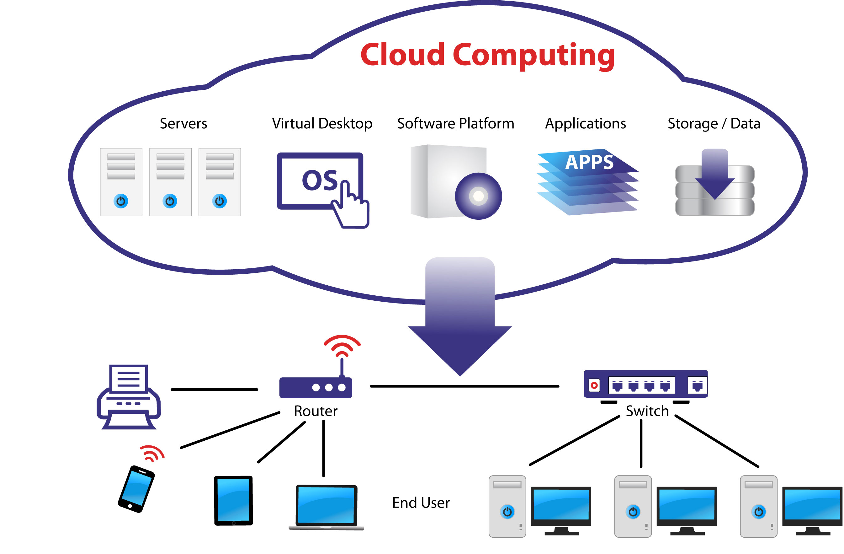
Cloud Computing

Slide 24
Cloud Models
Cloud Models is of two types namely
Service Models
Infrastructure As A Service (IaaS )
Platform As A Service (PaaS)
Software As A Service (SaaS)
Deployment Models
Public Cloud
Community Cloud
Hybrid Cloud
Private Cloud

Slide 25
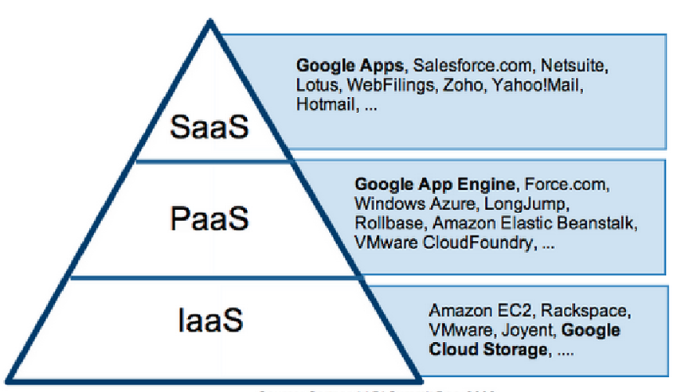
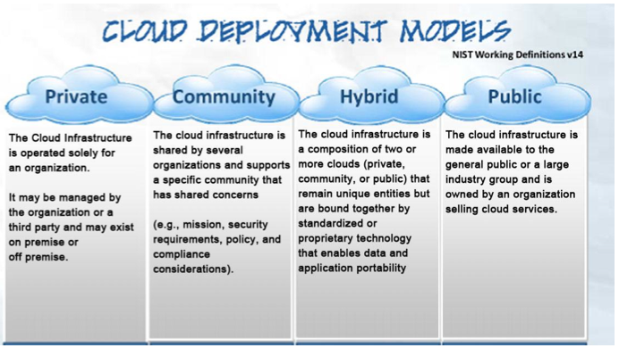
Cloud Models

Slide 26
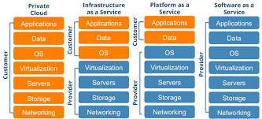
Cloud Models

Slide 27
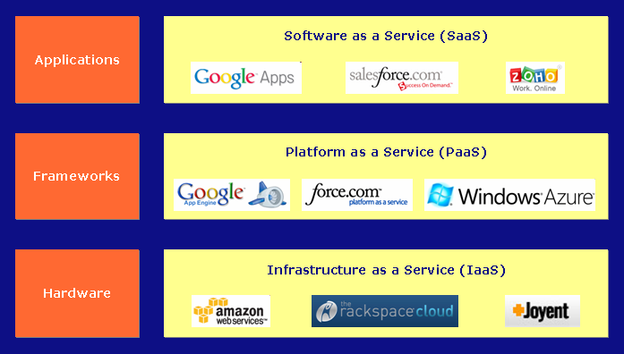
Cloud Models

Slide 28
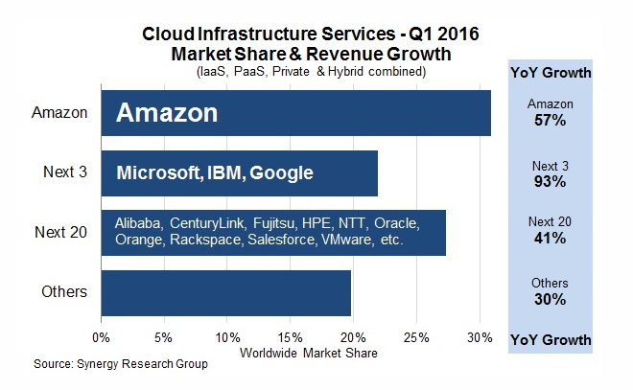
Cloud Market share

Slide 29
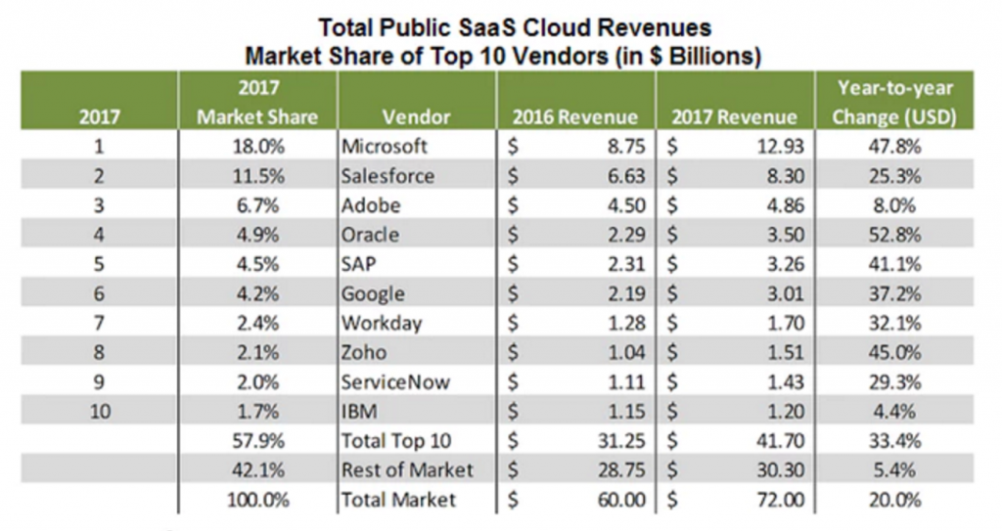
Cloud Market share - SaaS

Slide 30
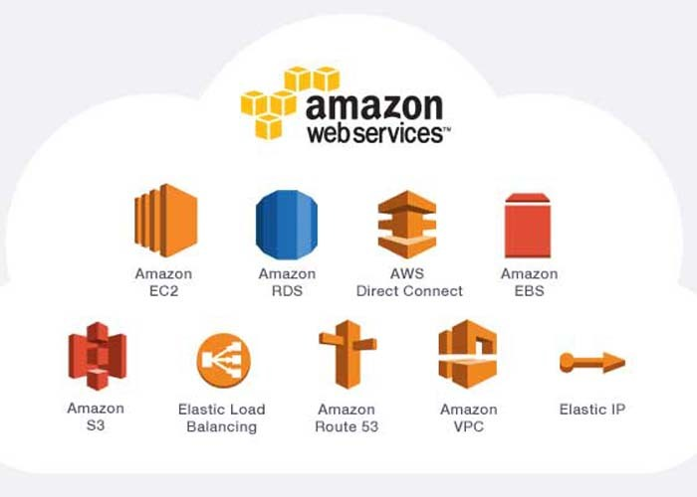
Amazon Web Services (AWS)

Slide 31
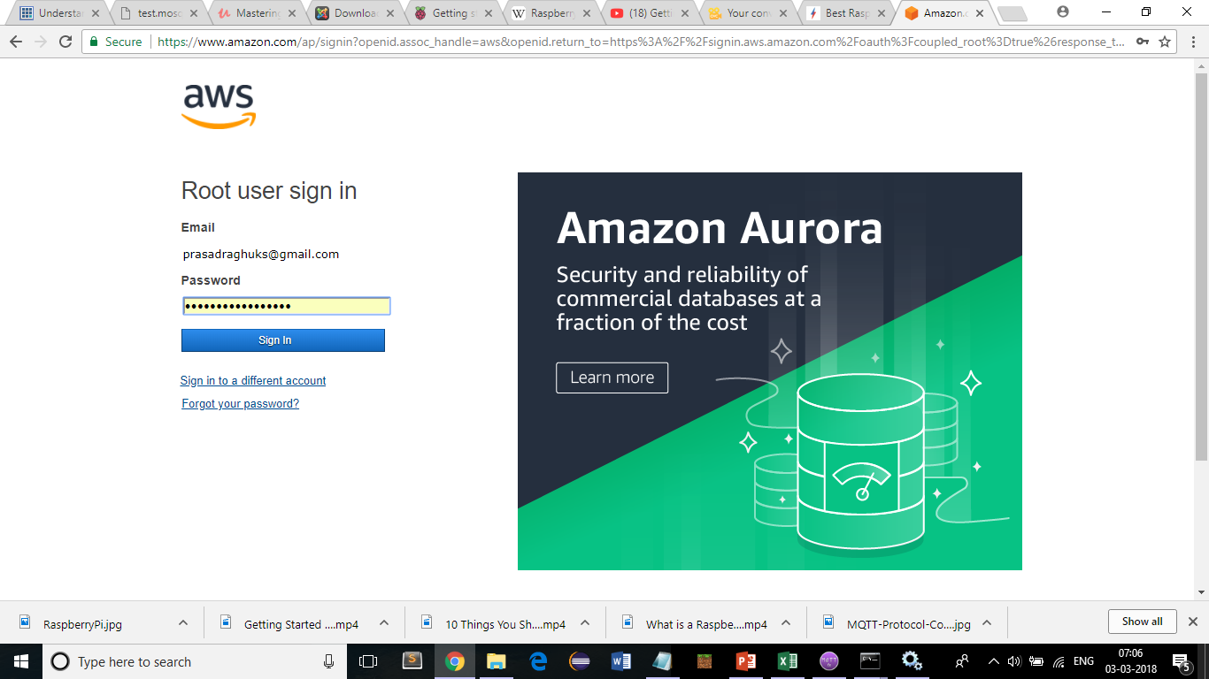
Amazon Web Services (AWS) https://aws.amazon.com/free/

Slide 32
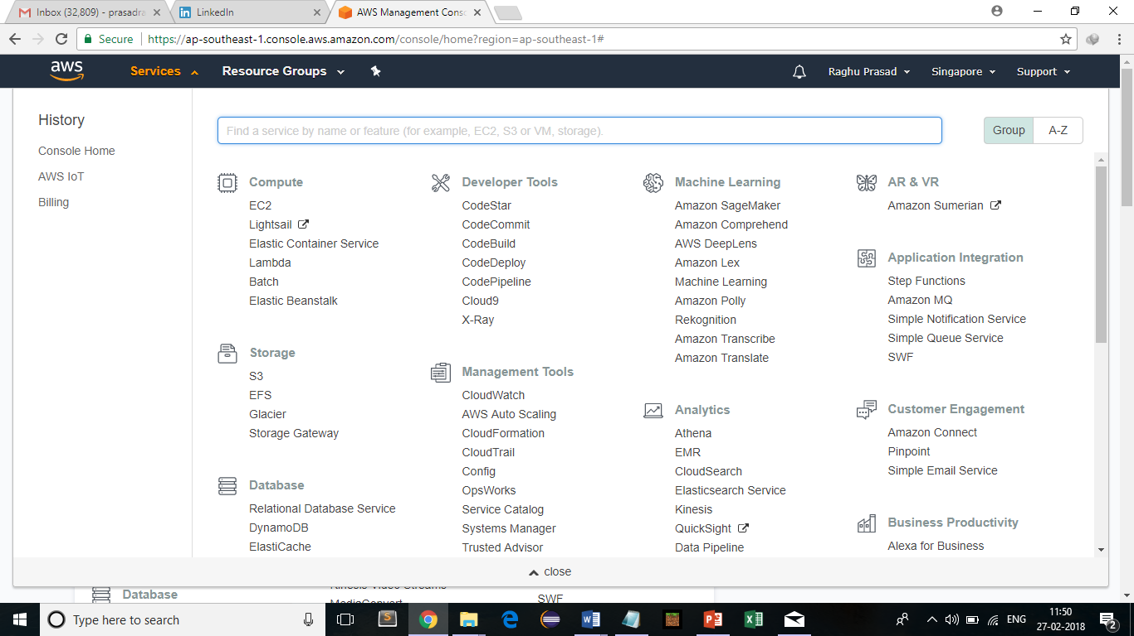
Amazon Web Services (AWS)

Slide 33
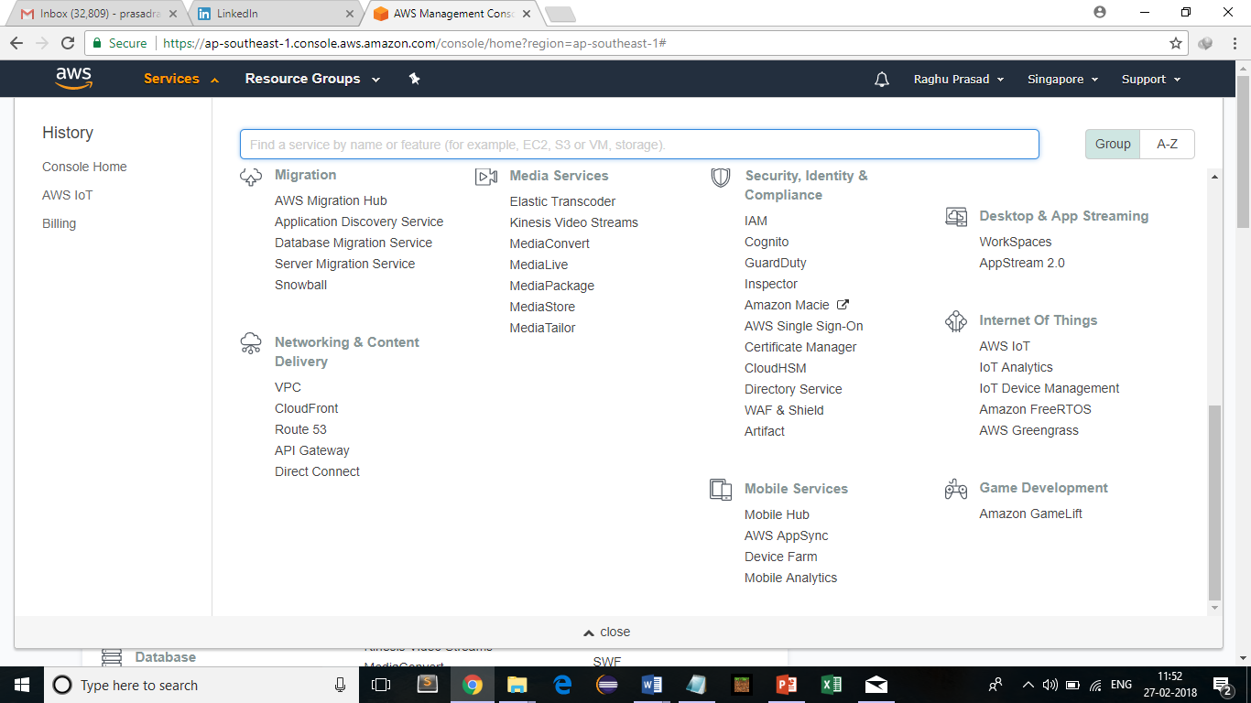
Amazon Web Services (AWS)

Slide 34
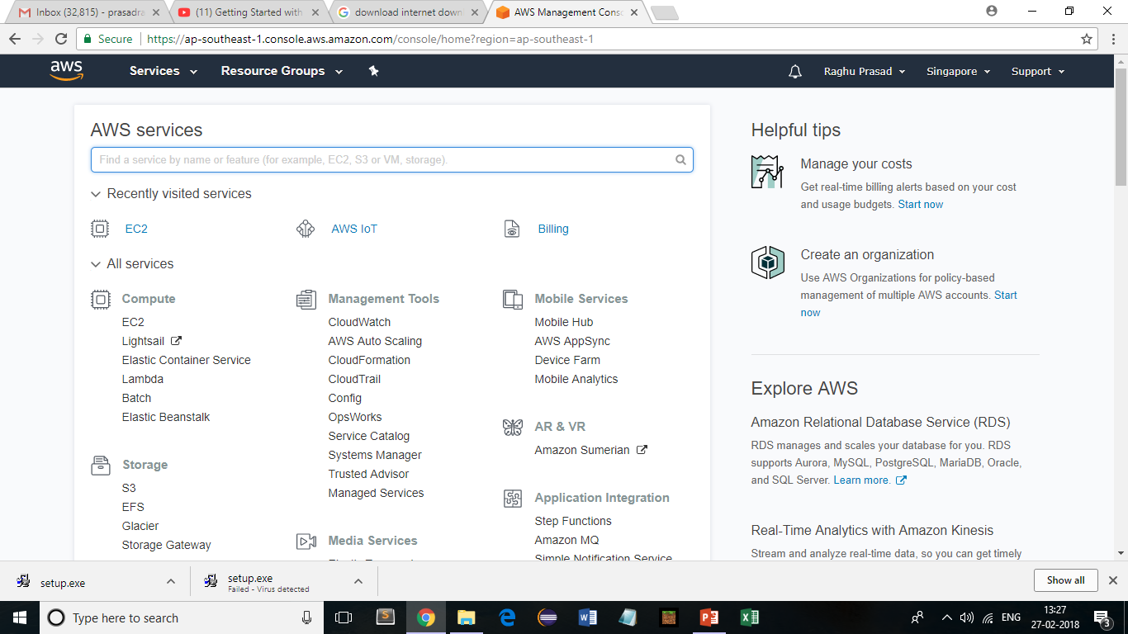
AWS-Getting started
Sign up using https://aws.amazon.com/
https://www.youtube.com/watch?v=ubCNZRNjhyo
Login

Slide 35
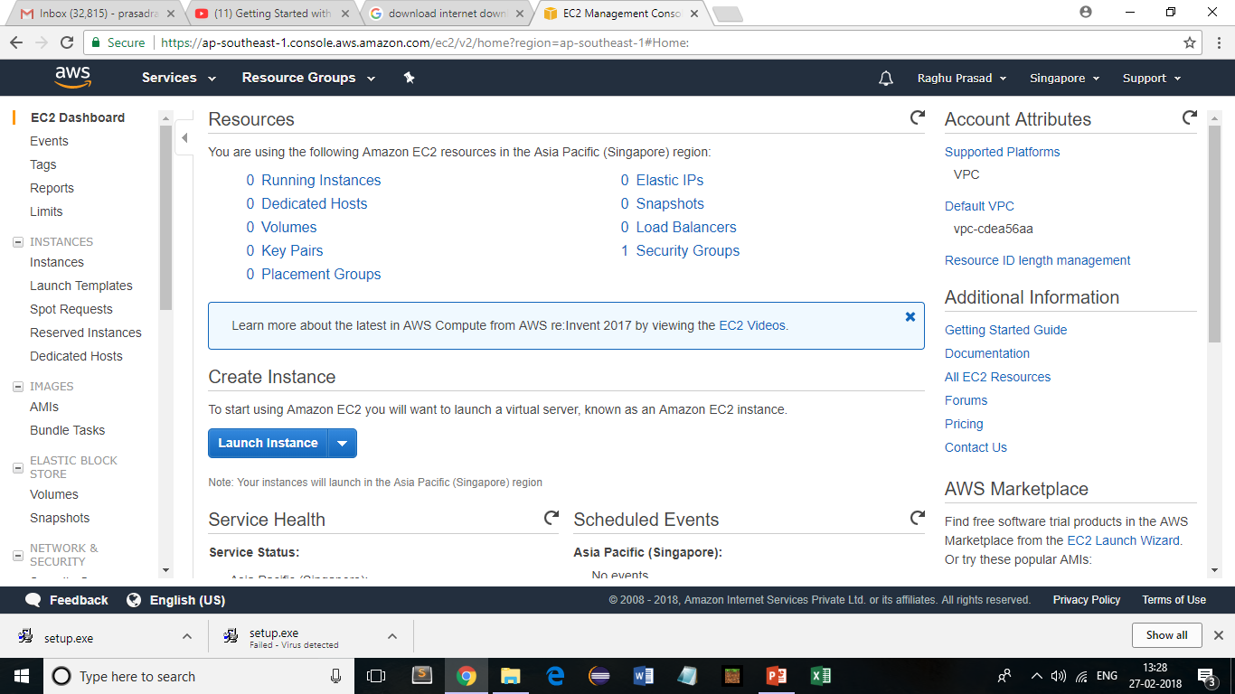
AWS-Getting started
Click EC2->Launch Instance

Slide 36
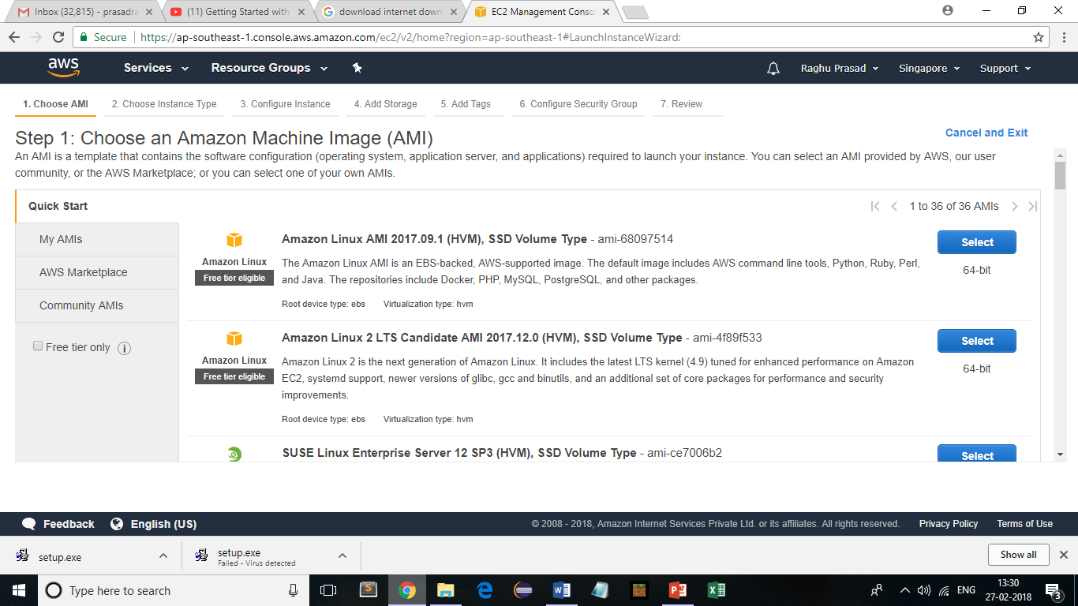
AWS-Getting started
Click EC2->Launch Instance->amazon Linux

Slide 37
AWS-Getting started
Click EC2->Launch Instance

Slide 38
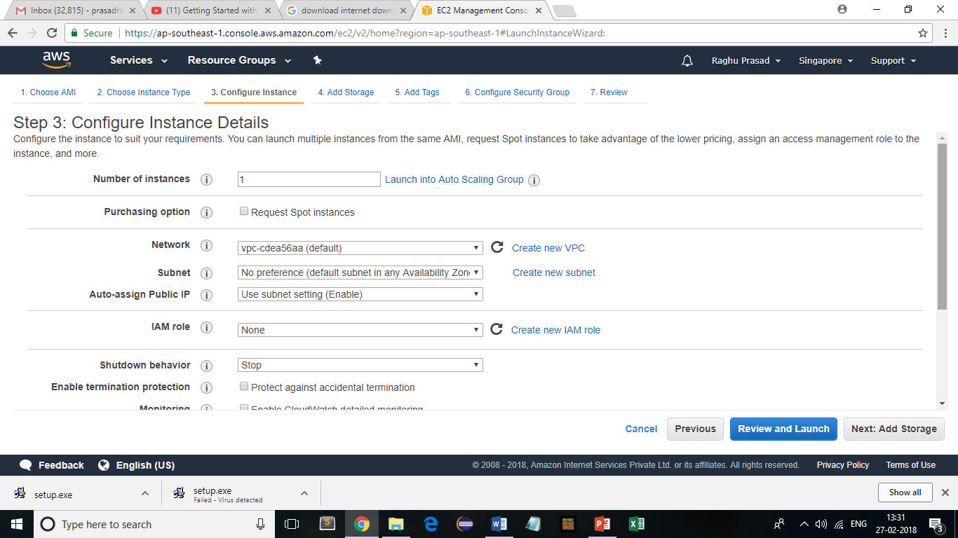
AWS-Getting started
Click EC2->Launch Instance

Slide 39
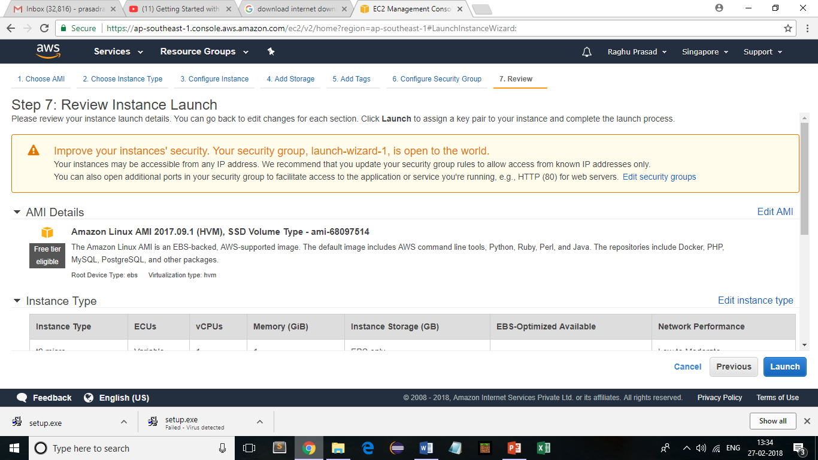
AWS-Getting started
Click EC2->Launch Instance

Slide 40
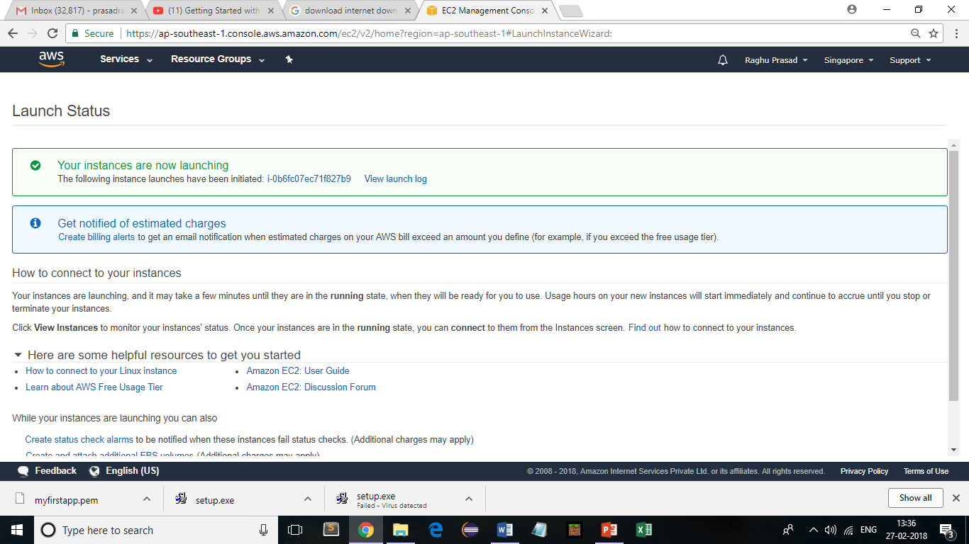
AWS-Getting started
Click EC2->Launch Instance

Slide 41
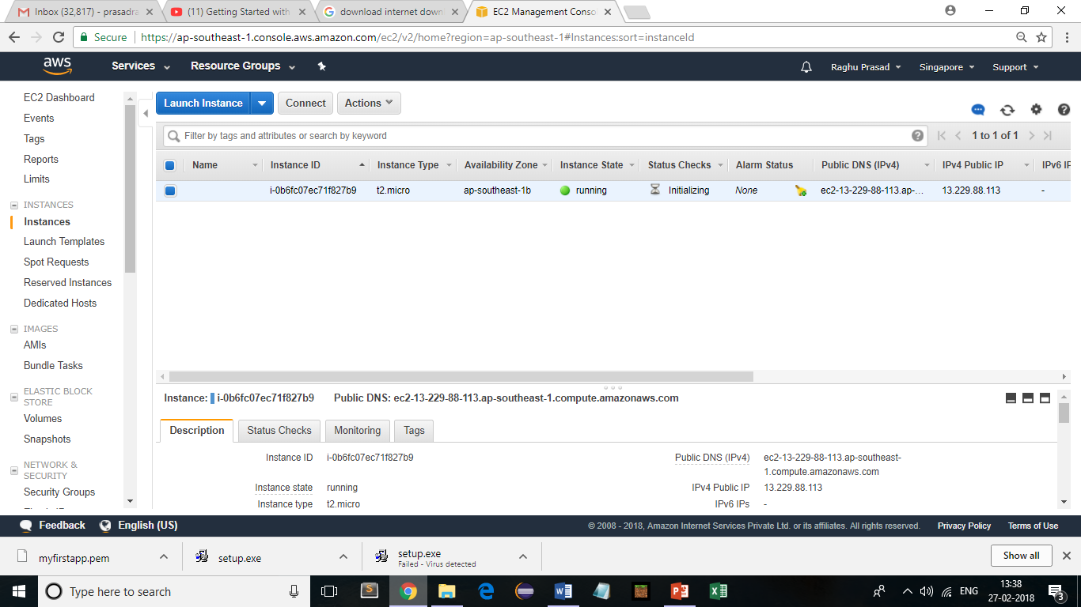
AWS-Getting started
Click EC2->Launch Instance

Slide 42
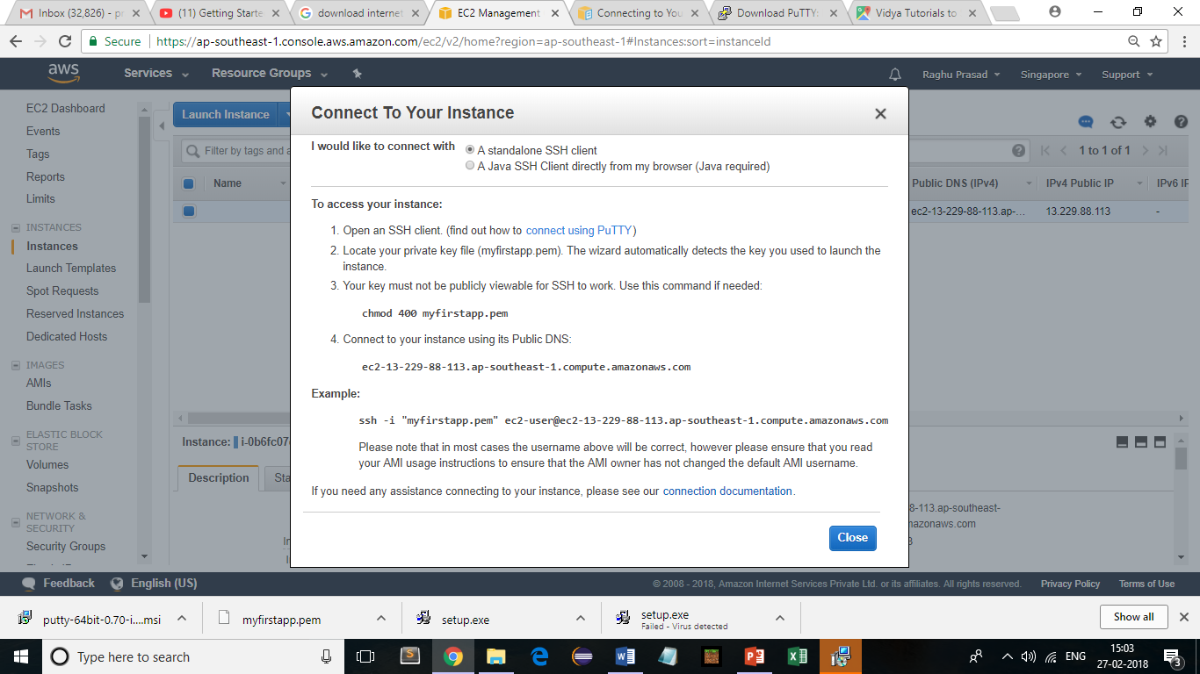
AWS-Connect using SSH
https://docs.aws.amazon.com/AWSEC2/latest/UserGuide/putty.html?icmpid=docs_ec2_console

Slide 43
What is an IoT platform ?
A platform is software and hardware, which may include an operating environment, storage, computing power, security, development tools, and many other common functions.
Platforms are designed to support many smaller application programs that actually solve business problems
Platforms are helpful because they abstract a lot of common functions away from the specific application logic
A good platform dramatically reduces the cost of developing and maintaining applications.
In the Internet of Things, platforms are designed to deploy applications that monitor, manage, and control connected devices. It stores the data securely and run analytics to make sense out of the data.
The IoT platforms are suites of components those help to setup and manage the internet connected devices. A person can remotely collect data, monitor and manage all internet connected devices from a single system. There are a bunch of IoT platforms available online but building an IoT solution for a company is all depend on IoT platform host and support quality
IoT platforms must handle problems like connecting and extracting data from a potentially vast number and variety of endpoints, which are sometimes in inconvenient locations with spotty connectivity.

Slide 44
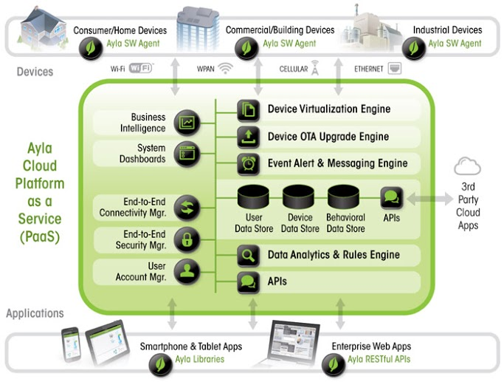
Key components of an IoT platform

Slide 45
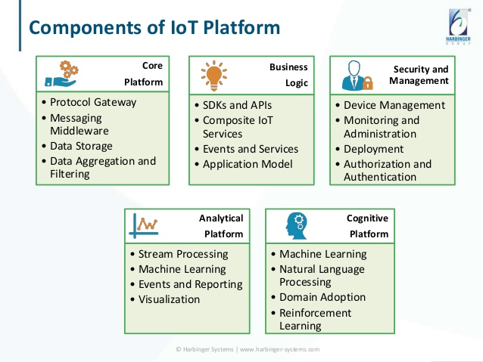
Key components of an IoT platform

Slide 46
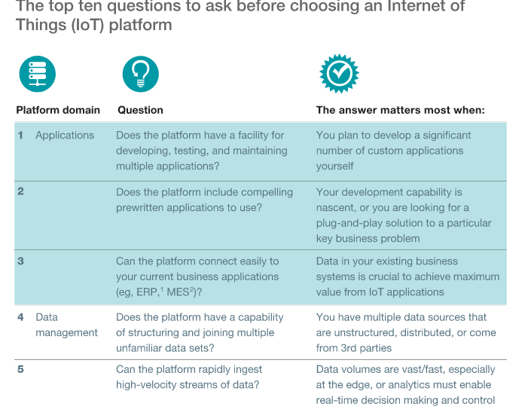
How to choose an IoT platform

Slide 47
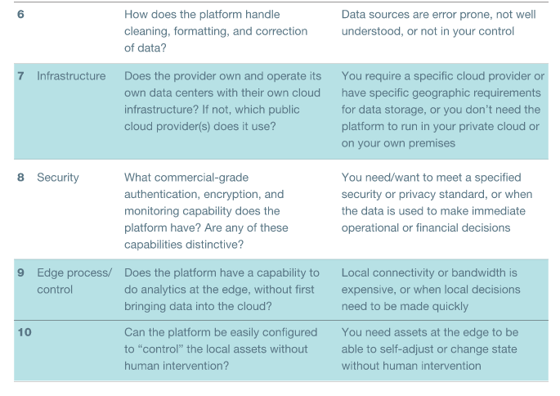
How to choose an IoT platform

Slide 48
Prominent commercial IoT platforms
Amazon Web Services (AWS) IoT
Microsoft Azure IoT
Google Cloud Platform
ThingWorx IoT Platform
IBM Watson
Samsung Artik
Cisco IoT Cloud Connect
HPE Universal of Things (IoT) Platform
Salesforce IoT Cloud
Mindsphere by Siemens
Bosch IoT Suite
Carriots
Oracle Integrated Cloud
General Electric’s Predix

Slide 49
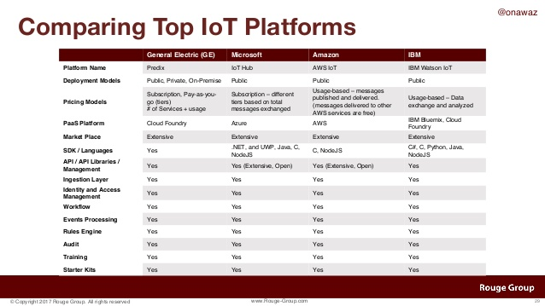
Comparison of few commercial IoT platforms

Slide 50
Prominent commercial IoT platforms
Amazon Web Services (AWS) IoT
Key Features
Registry for recognizing devices
Software Development Kit for devices
Device Shadows
Secure Device Gateway
Rules engine for inbound message evaluation
Easy facility for developers to connect sensors for multiple applications ranging from automobiles to turbines to smart home light bulbs.
Amazon has partnered with hardware manufacturers like Intel, Texas Instruments, Broadcom and Qualcomm to create starter kits compatible with their platform.

Slide 51
IoT platforms – AWS IoT
IoT Services
AWS IoT Core
AWS IoT Device Management
WS IoT Analytics
AWS IoT Button

Slide 52
IoT platforms – AWS IoT
IoT Services
AWS IoT Core
AWS IoT Core is a managed cloud platform that lets connected devices easily and securely interact with cloud applications and other devices. AWS IoT Core can support billions of devices and trillions of messages, and can process and route those messages to AWS endpoints and to other devices reliably and securely. With AWS IoT Core, your applications can keep track of and communicate with all your devices, all the time, even when they aren’t connected.

Slide 53
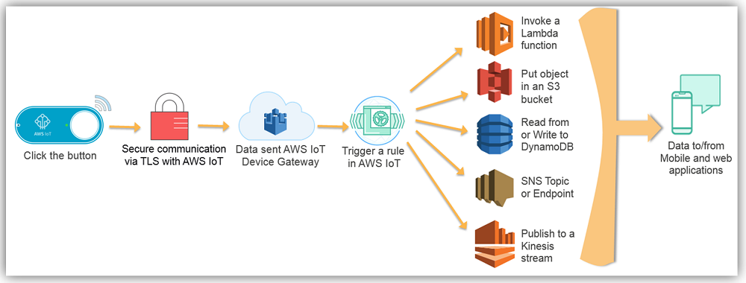
IoT platforms – AWS IoT

Slide 54
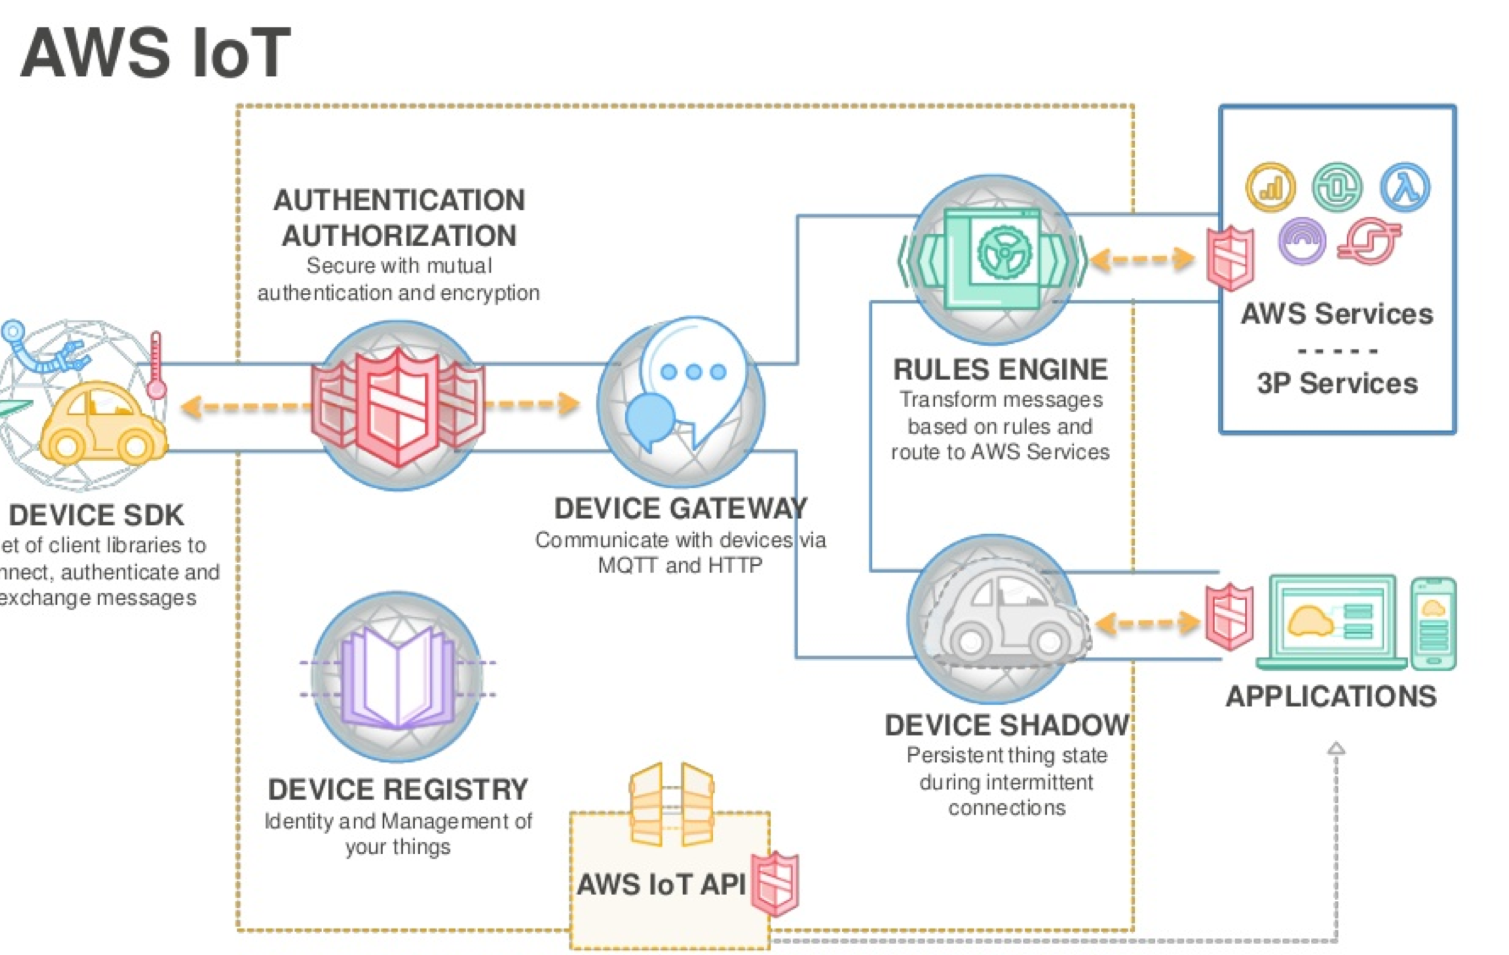
IoT platforms – AWS IoT
IoT Services

Slide 55
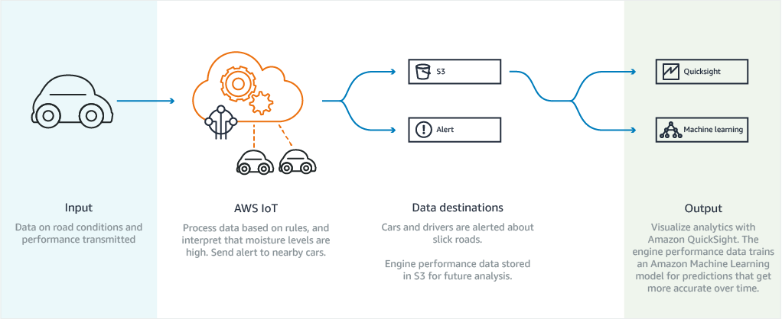
IoT platforms – AWS IoT
IoT Services

Slide 56
IoT platforms – ThingWorx
Thingworx is a platform for the rapid development and deployment of smart, connected devices. Its set of integrated IoT development tools support connectivity, analysis, production, and other aspects of IoT development.
Components
Thingworx offers several key tools for building applications. These tools include the Composer, the Mashup Builder, storage, a search engine, collaboration, and connectivity. The Composer provides a modeling environment for design testing. The Mashup Builder delivers easy dashboard building through common components (or widgets); for example, buttons, lists, wikis, gauges, and etc.
Thingworx uses a search engine known as SQUEAL, meaning Search, Query, and Analysis. Users employ SQUEAL in analyzing and filtering data, and searching records.

Slide 57
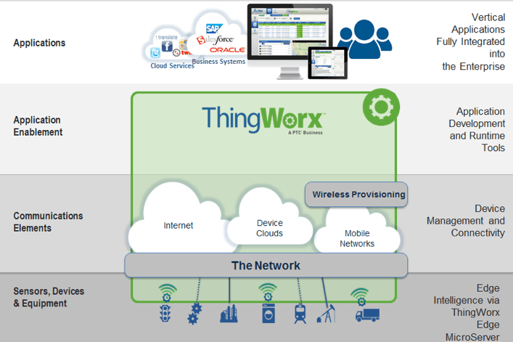
IoT platforms – Thingworx

Slide 58
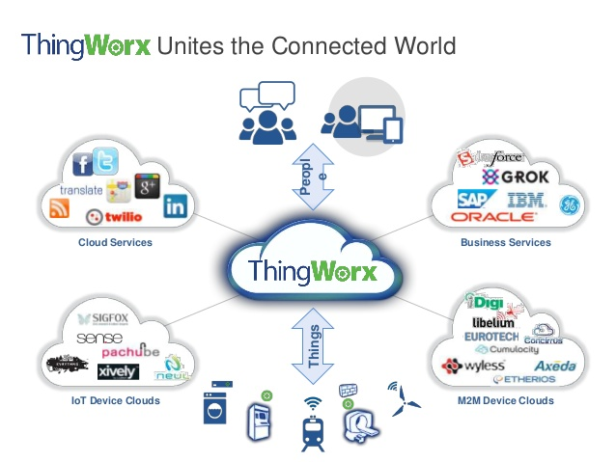
IoT platforms – ThingWorx

Slide 59
IoT platforms – Thingworx
Thingworx is a platform for the rapid development and deployment of smart, connected devices. Its set of integrated IoT development tools support connectivity, analysis, production, and other aspects of IoT development.
Components
Thingworx offers several key tools for building applications. These tools include the Composer, the Mashup Builder, storage, a search engine, collaboration, and connectivity. The Composer provides a modeling environment for design testing. The Mashup Builder delivers easy dashboard building through common components (or widgets); for example, buttons, lists, wikis, gauges, and etc.
Thingworx uses a search engine known as SQUEAL, meaning Search, Query, and Analysis. Users employ SQUEAL in analyzing and filtering data, and searching records.

Slide 60
Prominent opensource IoT platforms
Kaa IoT Platform
SiteWhere
ThingSpeak
DeviceHive
Zetta
DSA
ThingsBoard
Thinger.io
WSO2

Slide 61
Comparison of opensource platforms
IoT Software Platform | Device management? | Integration | Security | Protocols for data collection | Analytics | Support for visualizations? | DB
Kaa IoT Platform | Yes | Portable SDK available to integate any particular platfrom, REST API | Link Encryption (SSL), RSA key 2048 bits, AES key 256 bits | MQTT, CoAP, XMPP, TCP, HTTP | Real time IoT Data Analytics and Visualization with Kaa, Apache Cassandra and Apache Zappelin | Yes | MongoDB, Cassandra, Hadoop, Oracle NoSQL
SiteWhere | Yes | REST API, Mule AnyPoint, and more | Link Encryption (SSL), Spring Security | MQTT, AMQP, Stomp, WebSockets, and direct socket connections | Real-time analytics (Apache Spark) | No | MongoDB, HBase , InfluxDB
ThingSpeak | No | REST and MQTT APIs | Basic Authentication | HTTP | MATLAB Analytics | No | MySQL
DeviceHive | *Unknown | REST AP, MQTT APIs | Basic Authentication using JSON Web Tokens (JWT) | REST API, WebSockets or MQTT | Real-time analytics (Apache Spark) | Yes | PostgreSQL ,SAP Hana DB
Zetta | No | REST APIs | Basic Authentication | HTTP | Using Splunk | No | Unknown
Distributed Services Architecture (DSA) | NO | REST APIs | Basic Authentication | HTTP | No | No | ETSDB – Embedded Time Series
Thingsboard.io | Yes | REST APIs | Basic Authentication | MQTT, CoAP and HTTP | Real time analytics(Apache Spark, Kafka) | No | Cassandra
Thinger.io | Yes | REST APIs | Link Encryption (SSL/TLS) and basic authentication | MQTT, CoAP and HTTP | Yes | No | MongodB
WSo2 | Yes | REST APIs | Link Encryption (SSL) and basic authentication | HTTP, WSO2 ESB, MQTT | Yes, WSO2 Data Analytics Server | Yes | Oracle, PostgreSQL, MySQL, or MS SQL

Slide 62
IoT Consortiums
As vendors struggle to make sense of the Internet of Things, many are realizing the need for consistent standards and broad interoperability for a seamless, connected ecosystem around IoT
Over the past few years, industry titans such as Intel and Cisco Systems have come together to form alliances and consortiums around the various components of the Internet of Things – including communications and broadband, connected buildings, connected home and industrial IoT.

Slide 63
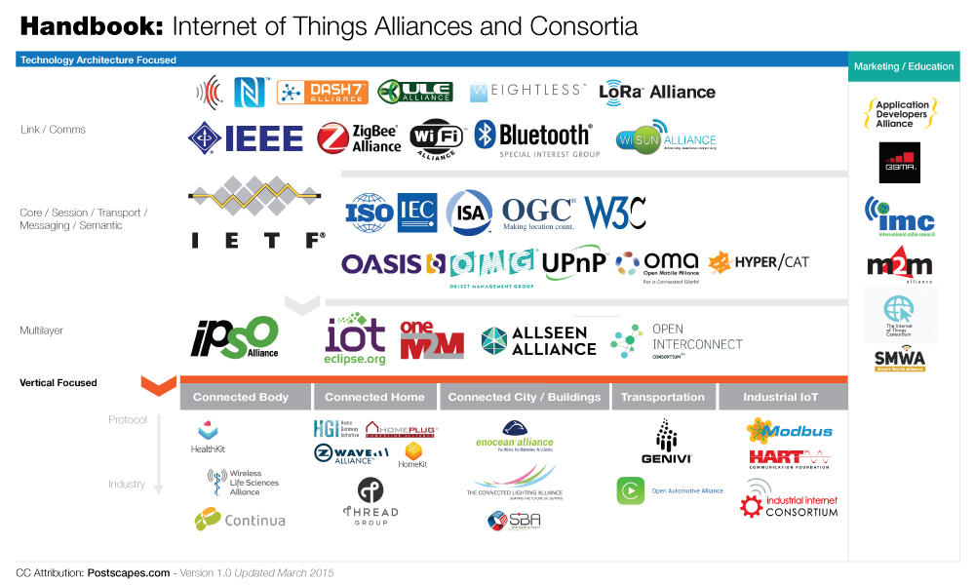
IoT Consortiums

Slide 64
IoT Consortiums
The Industrial Internet Consortium was founded by Intel, IBM, GE, Cisco and AT&T in 2014.
This consortium aims to set the architectural framework for industrial IoT by coordinating various ecosystem initiatives to connect objects using common architectures, interoperability and open standards – making it easier to adopt interconnected machines and intelligent analytics.
Who It Impacts: Solution providers and systems integrators that want to build Internet of Things practices in the industrial space.
IEEE
The IEEE IoT Initiative was launched in 2014 by IEEE Future Directions and aims to help engineering and technology professionals learn, share knowledge and collaborate around IoT.
IEEE has a variety of programs that can help solution providers that are trying to understand IoT, including the IEEE Technical Community, which is made up of members involved in research, application and implementation of IoT
Who It Impacts: Solution providers that would like to better understand how to monetize the Internet of Things and are looking for real-life applications.

Slide 65
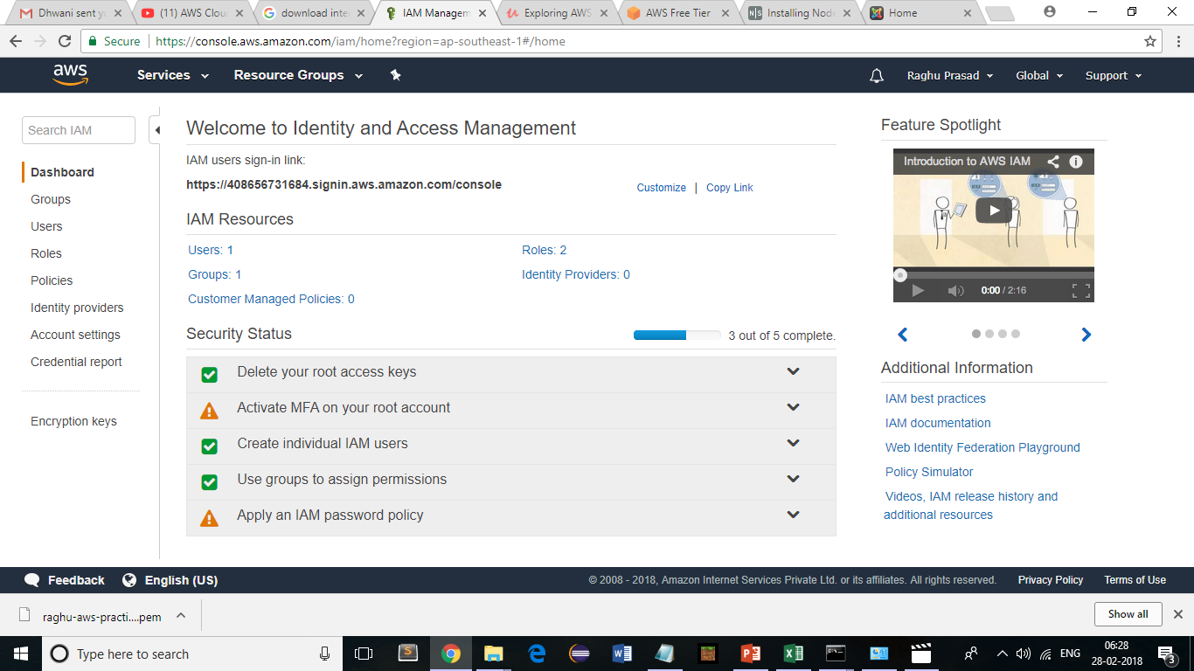
AWS IoT – Deep dive
IAM – Manage User Access and Encryption Keys

Slide 66
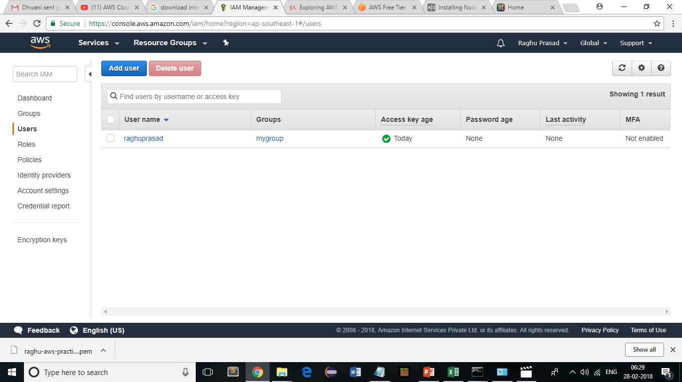
AWS IoT – Deep dive
Users – Add User

Slide 67
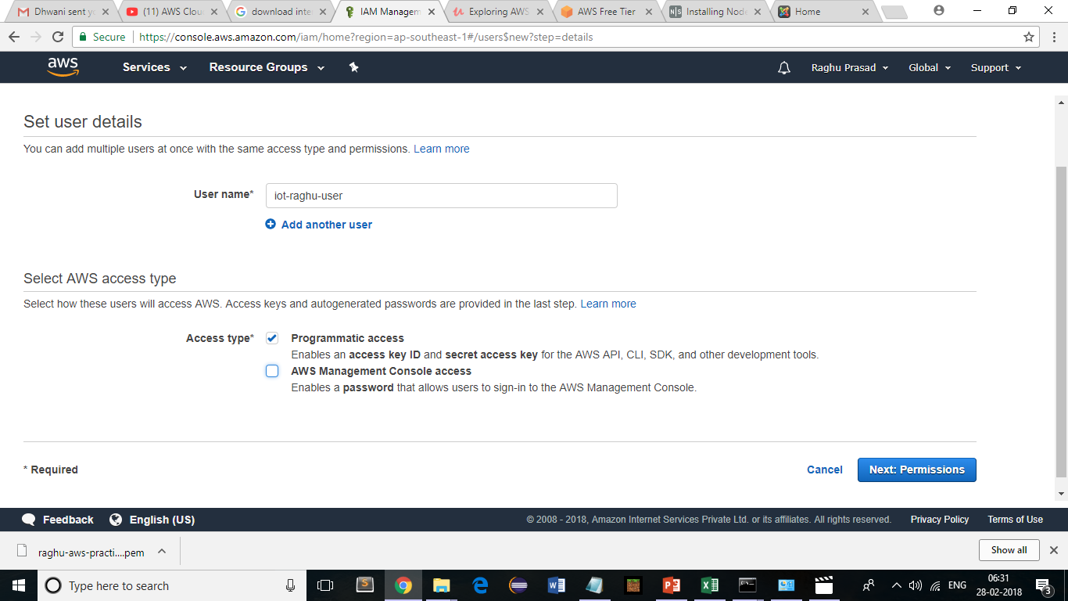
AWS IoT – Deep dive
Add User

Slide 68
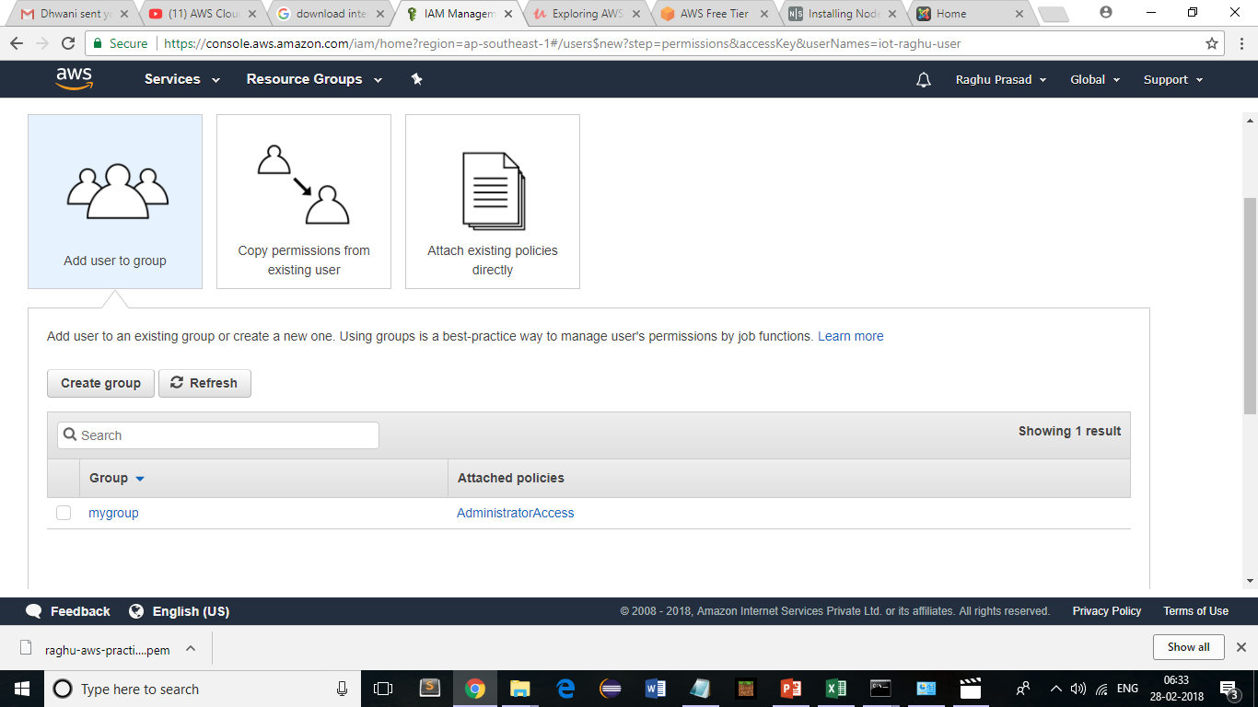
AWS IoT – Deep dive
Groups

Slide 69
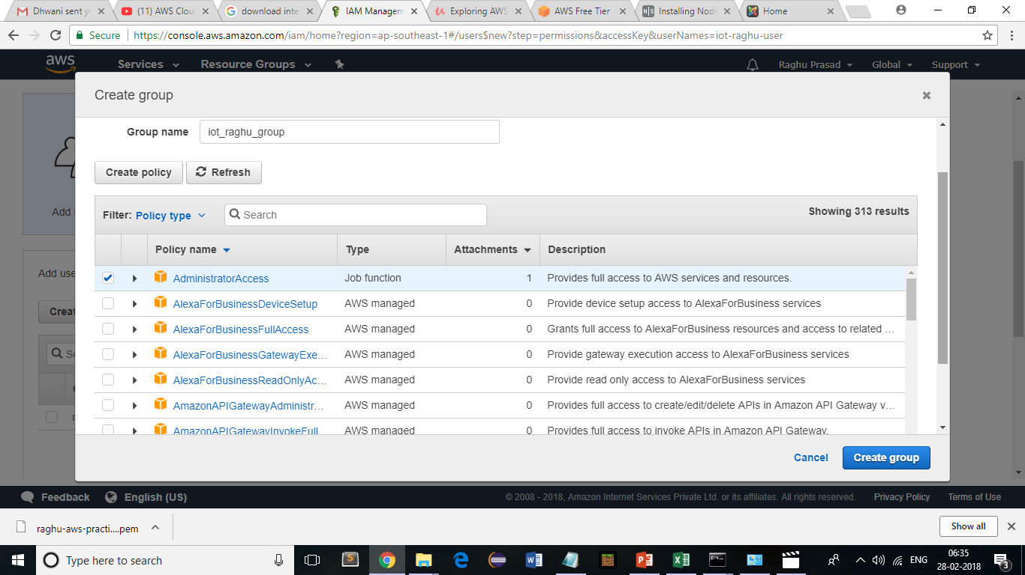
AWS IoT – Deep dive
Groups

Slide 70
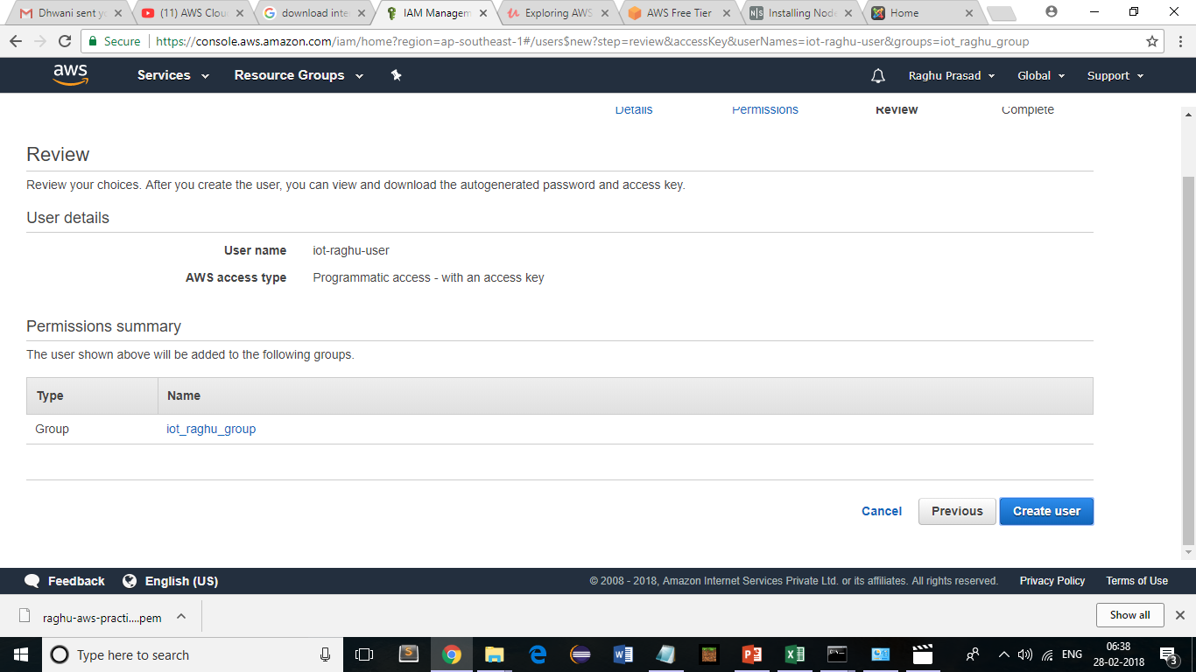
AWS IoT – Deep dive
Groups

Slide 71
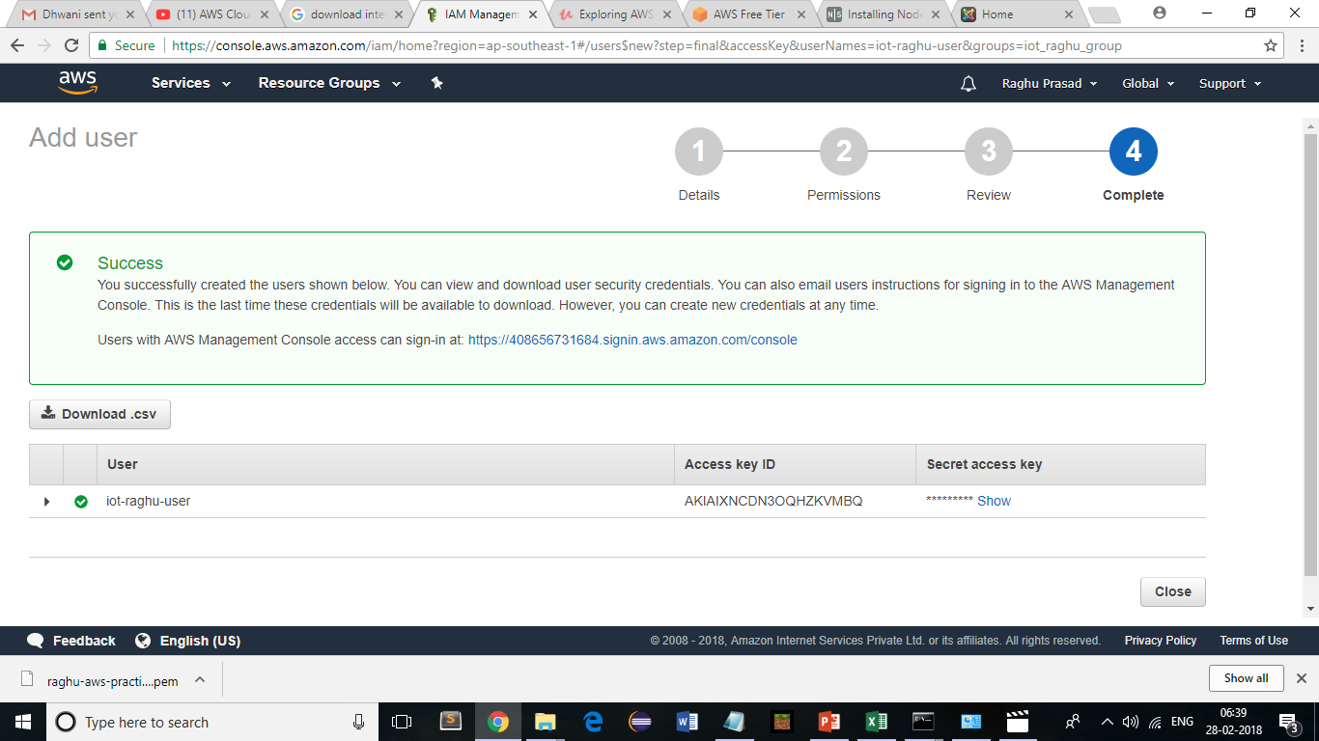
AWS IoT – Deep dive
Groups

Slide 72
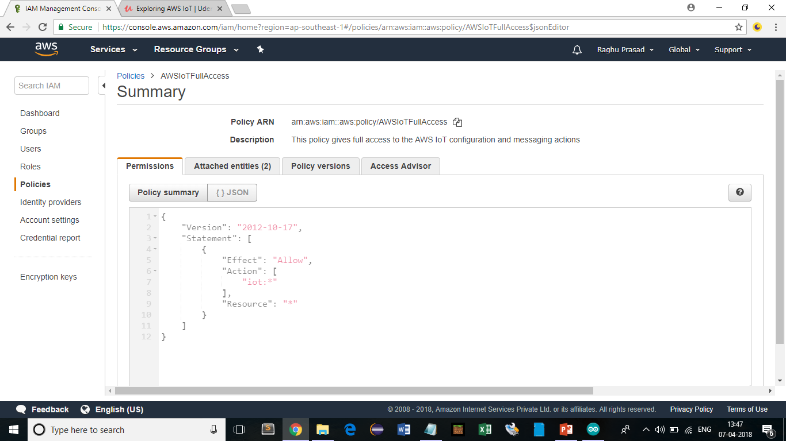
AWS IoT – Deep dive
Groups

Slide 73
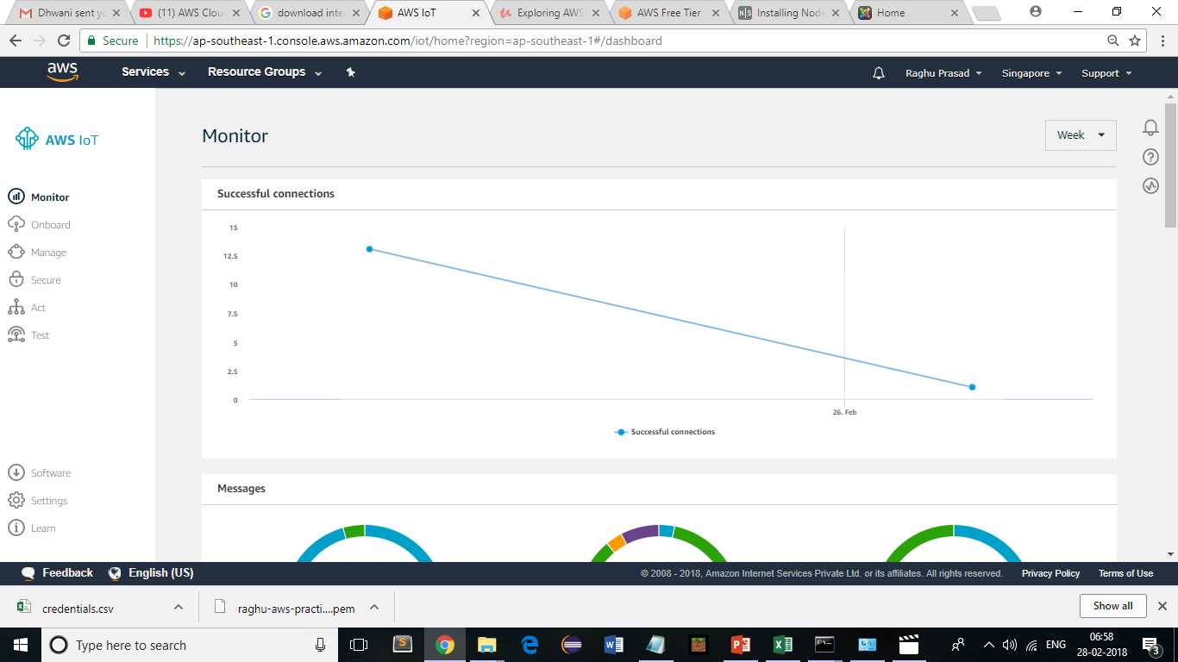
AWS IoT – Deep dive
AWS-Iot

Slide 74

AWS IoT – Deep dive
AWS-Iot-secure-certificates-create

Slide 75

AWS IoT – Deep dive
Create a certificate – One click

Slide 76

AWS IoT – Deep dive
Create a certificate – Download certificate - Activate

Slide 77

AWS IoT – Deep dive
Create a certificate – Download certificate – Attach a policy

Slide 78

AWS IoT – Deep dive
Create a certificate – Download certificate – create new policy

Slide 79

AWS IoT – Deep dive
Advance mode

Slide 80

AWS IoT – Deep dive
Add Statement

Slide 81

AWS IoT – Deep dive
Add Statement

Slide 82

AWS IoT – Deep dive
Policy created

Slide 83

AWS IoT – Deep dive
Activate certificate

Slide 84

AWS IoT – Deep dive
Attach policy

Slide 85

AWS IoT – Deep dive
Attach policy

Slide 86

AWS IoT – Deep dive
Certificate is active

Slide 87

AWS IoT – MQTT.fx
Broker End point

Slide 88

AWS IoT – Deep dive
MQTT.fx

Slide 89

AWS IoT – Deep dive
AWS – IoT - Subscribe

Slide 90

AWS IoT – Deep dive
MQTT-Publish

Slide 91

AWS IoT – Deep dive
AWS - IoT

Slide 92

AWS IoT – Actions
Actions- SNS Action

Slide 93

AWS IoT – Actions
Actions- SNS Action

Slide 94

AWS IoT – Actions
Actions- SNS Action

Slide 95

AWS IoT – Actions
Actions- SNS Action

Slide 96

AWS IoT – Actions
Actions- SNS Action

Slide 97

AWS IoT – Actions
Actions- SNS Action

Slide 98

AWS IoT – Actions
Actions- SNS Action

Slide 99

AWS IoT – Actions
Actions- SNS Action

Slide 100

AWS IoT – Actions
Actions- SNS Action

Slide 101

AWS IoT – Actions – E-Mail
Act->Create a rule

Slide 102
AWS IoT – Actions – E-Mail
Act->Create a rule

Slide 103

AWS IoT – Actions – E-Mail
Act->Create a rule

Slide 104

AWS IoT – Actions – E-Mail
SNS push notification

Slide 105

AWS IoT – Actions – E-Mail
New resource

Slide 106

AWS IoT – Actions – E-Mail
New resource

Slide 107

AWS IoT – Actions – E-Mail
New Topic

Slide 108

AWS IoT – Actions – E-Mail
Subscribe to a topic

Slide 109

AWS IoT – Actions – E-Mail
Email Notification

Slide 110

AWS IoT – Actions – E-Mail
Confirm a subscription

Slide 111

AWS IoT – Actions – E-Mail
Confirm a subscription

Slide 112

AWS IoT – Actions – E-Mail
New Resource and Role

Slide 113

AWS IoT – Actions – E-Mail
New Resource and Role

Slide 114

AWS IoT – Actions – E-Mail
Test

Slide 115

AWS IoT – Actions – E-Mail
Test

Slide 116

AWS IoT – Conditional Data Testing

Slide 117

AWS IoT – Conditional Data Testing

Slide 118

AWS IoT – Conditional Data Testing

Slide 119

AWS IoT – Conditional Data Testing

Slide 120
AWS IoT
Simple Storage Service (S3)

Slide 121

AWS IoT – S3
Simple Storage Service (S3)

Slide 122

AWS IoT – S3
Simple Storage Service (S3)

Slide 123

AWS IoT – S3
Simple Storage Service (S3)

Slide 124

AWS IoT – S3
Simple Storage Service (S3)

Slide 125

AWS IoT – S3
Simple Storage Service (S3)

Slide 126

AWS IoT – S3
Simple Storage Service (S3)

Slide 127

AWS IoT – S3
Simple Storage Service (S3)

Slide 128

AWS IoT – S3
Simple Storage Service (S3)

Slide 129

AWS IoT – S3
Simple Storage Service (S3)

Slide 130

AWS IoT – S3
Simple Storage Service (S3)

Slide 131

AWS IoT – S3
Simple Storage Service (S3)

Slide 132
AWS IoT – Kinesis Firehose
Kinesis Firehose

Slide 133

AWS IoT – Kinesis Firehose

Slide 134

AWS IoT – Kinesis Firehose

Slide 135

AWS IoT – Kinesis Firehose

Slide 136

AWS IoT – Kinesis Firehose

Slide 137

AWS IoT – Kinesis Firehose

Slide 138

AWS IoT – Kinesis Firehose

Slide 139

AWS IoT – Kinesis Firehose

Slide 140

AWS IoT – Kinesis Firehose

Slide 141

AWS IoT – Kinesis Firehose

Slide 142

AWS IoT – Kinesis Firehose

Slide 143

AWS IoT – Kinesis Firehose

Slide 144

AWS IoT – Kinesis Firehose

Slide 145

AWS IoT – Kinesis Firehose

Slide 146

AWS IoT – Kinesis Firehose

Slide 147

AWS IoT – Kinesis Firehose

Slide 148

AWS IoT – Kinesis Firehose

Slide 149

AWS IoT – Kinesis Firehose

Slide 150
AWS IoT – DynamoDB
DynamoDB

Slide 151

AWS IoT – DynamoDB

Slide 152

AWS IoT – DynamoDB

Slide 153

AWS IoT – DynamoDB

Slide 154

AWS IoT – DynamoDB

Slide 155

AWS IoT – DynamoDB

Slide 156

AWS IoT – DynamoDB

Slide 157

AWS IoT – DynamoDB

Slide 158

AWS IoT – Data Pipeline
Move data from DynamoDB to S3

Slide 159

AWS IoT – Data Pipeline
Search for Data Pipeline in services (North Virginia)
Create Pipeline

Slide 160

AWS IoT – Data Pipeline

Slide 161

AWS IoT – Data Pipeline

Slide 162

AWS IoT – Data Pipeline

Slide 163

AWS IoT – Data Pipeline

Slide 164

AWS IoT – Glue
Fully managed extract,transform and Load (ETL) service that makes it easy for customers to prepare and load data for analytics

Slide 165

AWS IoT – Glue

Slide 166

AWS IoT – Glue Crawl data
Search Glue. Add tables using a crawler

Slide 167

AWS IoT – Glue Crawl data

Slide 168

AWS IoT – Glue Crawl data

Slide 169

AWS IoT – Glue Crawl data

Slide 170

AWS IoT – Glue Crawl data

Slide 171

AWS IoT – Glue Crawl data

Slide 172

AWS IoT – Glue Crawl data

Slide 173

AWS IoT – Glue Crawl data

Slide 174

AWS IoT – Glue Crawl data

Slide 175

AWS IoT – Glue Crawl data

Slide 176

AWS IoT – Glue Crawl data

Slide 177
AWS IoT – ETL Jobs

Slide 178
AWS IoT – ETL Jobs

Slide 179

AWS IoT – ETL Jobs

Slide 180

AWS IoT – ETL Jobs

Slide 181

AWS IoT – ETL Jobs

Slide 182

AWS IoT – ETL Jobs

Slide 183

AWS IoT – ETL Jobs

Slide 184

AWS IoT – ETL Jobs

Slide 185

AWS IoT – ETL Jobs

Slide 186

AWS IoT – ETL Jobs

Slide 187

AWS IoT – ETL Jobs

Slide 188

AWS IoT – ETL Jobs

Slide 189

AWS IoT – ETL Jobs

Slide 190

AWS QuickSight

Slide 191

AWS QuickSight

Slide 192

AWS QuickSight

Slide 193

AWS QuickSight

Slide 194

AWS QuickSight

Slide 195

AWS QuickSight

Slide 196

IoT Data analytics

Slide 197

IoT Data analytics

Slide 198

IoT Data analytics

Slide 199
Thank You
Raghu Prasad
9845547471
www.kaushalya.tech
FB : https://www.facebook.com/raghuprasadkonandur/
Skill Up-Skill Re-Skill
Excellence in action

